Slide 2
OUR PROCESS
5
4
3
2
1
Board reaches agreement on proposal and
calls a millage election
Citizens committee makes proposal to board of education
Committee reviews options & develops consensus
agreement
Committee tours facilities & reviews existing facility conditions and district operations
District forms
citizens committee

Slide 3
NEW 5-YEAR STRATEGIC PLAN
Emphasis Areas
Career Planning
Equity
Instruction
Learning Environments/Facilities
Staffing
Technology
Wellness

Slide 4
STRATEGIC GOALS
Set future priorities for district
Equitable access
Well-being/mental health
Career and college pathways
Pre-K through 12 education
Safe, nurturing, welcoming
Best for students
Responsible stewardship
No compromising excellence

Slide 5
Citizen’s Committee Purpose
Collaboratively study and prioritize the district’s most critical needs, outlined in the FSPS Strategic Five Year Plan, and make a thoughtful recommendation and presentation to the Board of Education regarding next steps to implement Vision 2023.
FOR THE COMMUNITY
BY THE COMMUNITY

Slide 6
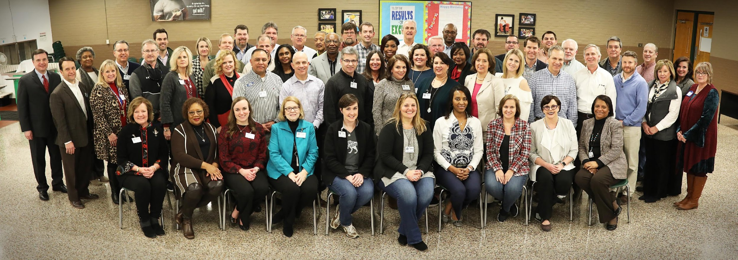
Our Investment
5 Meetings • 57 People • 900+ Hours

Slide 7
The Committee Did Their Homework
District Overview
FSPS Demographic Report
Facility Needs Assessment
Financial Capacity and Impact
Campus and Facility Tours
Project Prioritization

Slide 8
District Wide Facility Assessment
District Maintenance Staff – maintain facilities well
Many opportunities exist for district efficiency
Facilities | Operations | Transportation | Food Service
Identified / prioritized entire district needs
Technology – serves students well, requires updates
Food Services – upgrades to changing standards to be applied
District efficiently utilizes all facilities – with limited flexibility – and currently forces the transfer of 450 students each year
AVERAGE AGE
63
YEARS

Slide 9
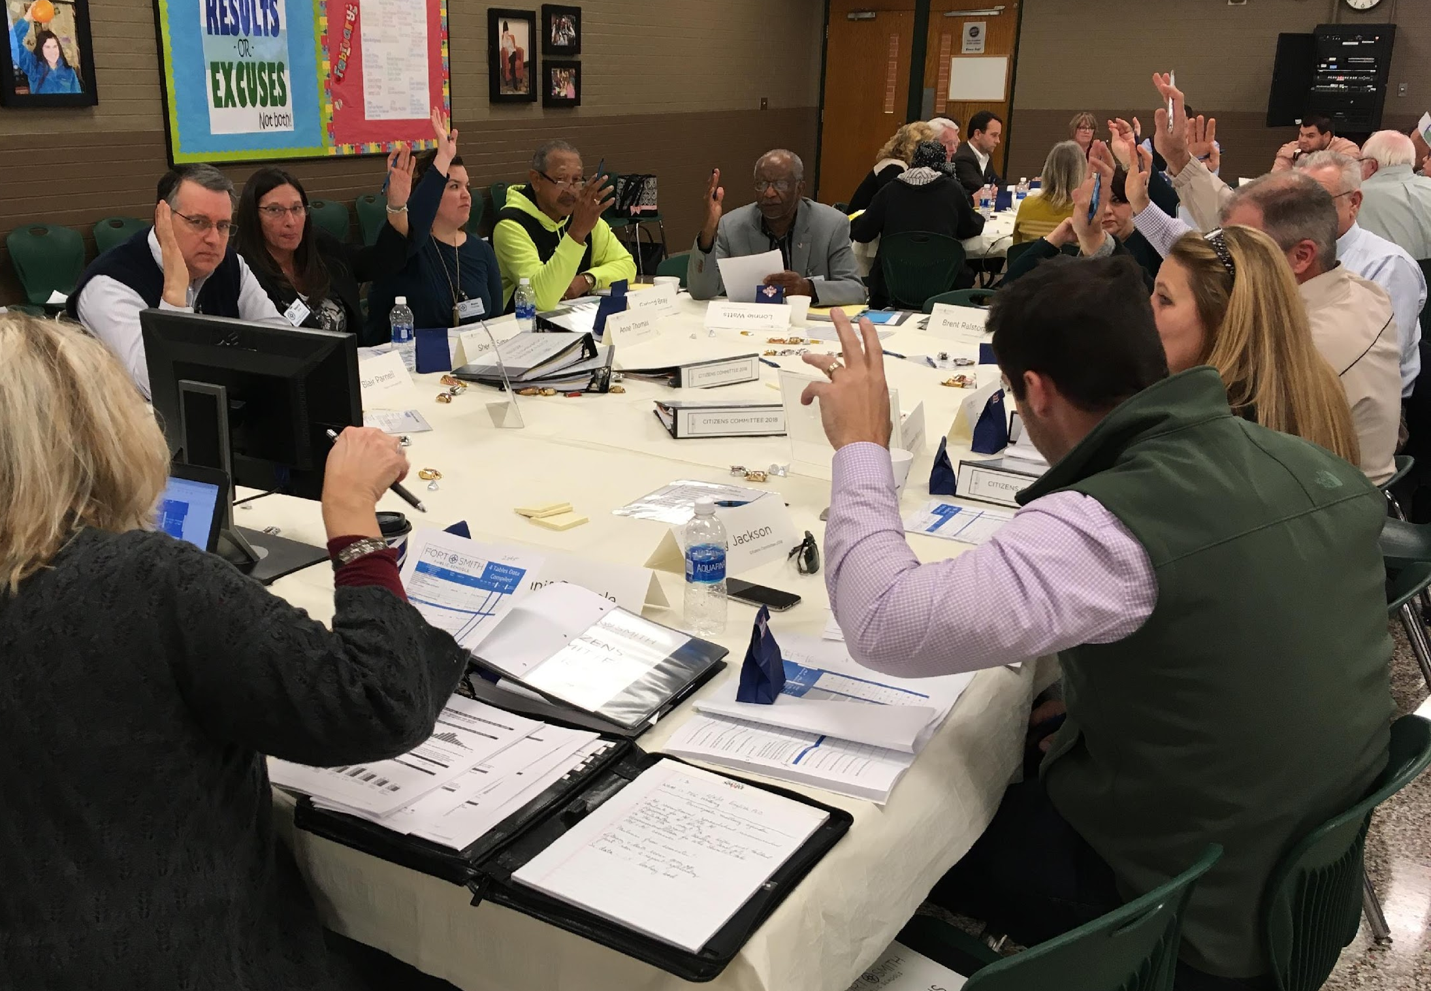
Prioritization of Projects & Needs
15 Items
reduced from 65
$120 Million
reduced from $658 Million
*6.888 Mills
reduced from 41.2 Mills
*Committee supports reduction of original proposal amount or scope

Slide 10
Changes to Citizens Committee Proposal
Reduced interest rate calculation from 4.5% to 4.0%
Staffing recommendations removed
Ramsey Junior High Secure Entry added
Student device 1:1 project cost reduced
Wireless networking to support 1:1 removed

